Slide 1
What you need to know or show
A basic awareness of what the practical is trying to find out or demonstrate.
The equipment in the practical and what it does.
The science underpinning the practical.
Key points of the methods (you can’t remember every detail).
Control variables and safety/risk factors.

Slide 2
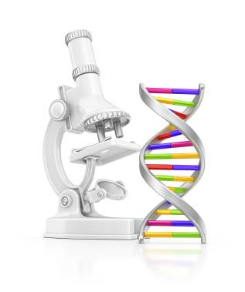
Edexcel GCSE 9-1 Science
Biology Practicals
Looking at cells | Investigate biological specimens using microscopes including magnification calculations.
pH and enzyme activity | Investigate the effect of pH on enzyme activity using amylase (in solutions of different pH) to break down starch.
Food tests (Separate Only) | Investigate the use of chemical reagents to identify starch, reducing sugars, proteins and fats.
Osmosis in potato strips | Investigate osmosis in potatoes in different strength sugar solutions.
Microbial cultures (Separate Only) | Investigate the effects of antiseptics, antibiotics or plant extracts on microbial cultures using paper discs of the chemical on a bacterial plate.
Photosynthesis | Investigate the effect of light intensity on the rate of photosynthesis using pondweed.
Respiration | Investigate the rate of respiration in living organisms using woodlice.
Fieldwork | Investigate the relationship between organisms and their environment using field-work techniques, including quadrats and belt transects.

Slide 3
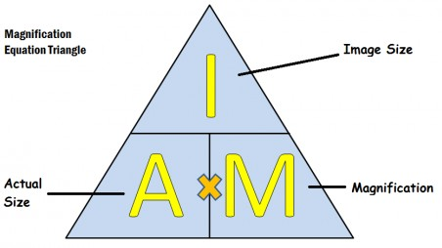
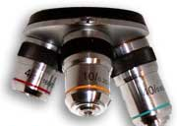
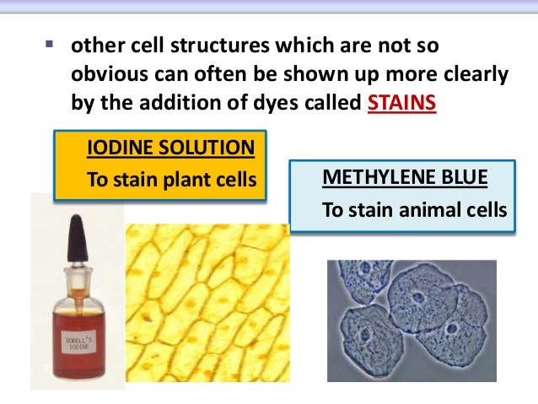
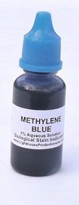
8 Practicals. A quick Recap.
Remember to Aim!
Image size
1. Microscopes
Magnification
Actual size
These are “objectives”, they contain glass lenses

Slide 4
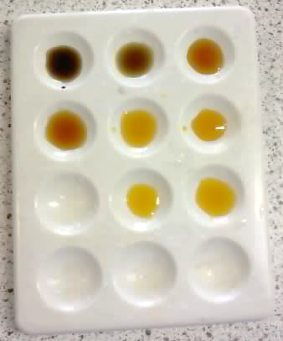
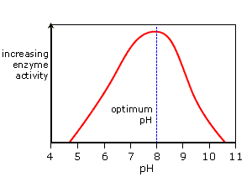
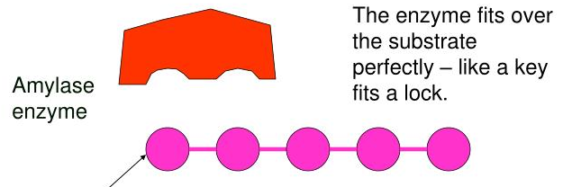
8 Practicals. A quick Recap.
SPOTTING TILE!
2. pH and enzymes
We did the SAME reaction at DIFFERENT pHs
Time taken for enzyme to work
We took a sample every 20 sec.
sugar
sugar
sugar
sugar
sugar
sugar
Sugars joined together make STARCH, a carbohydrate

Slide 5
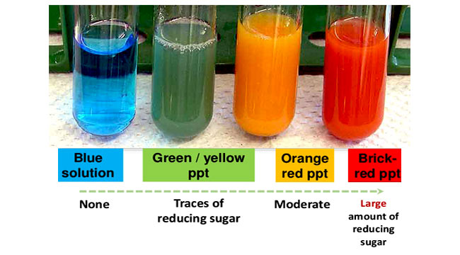
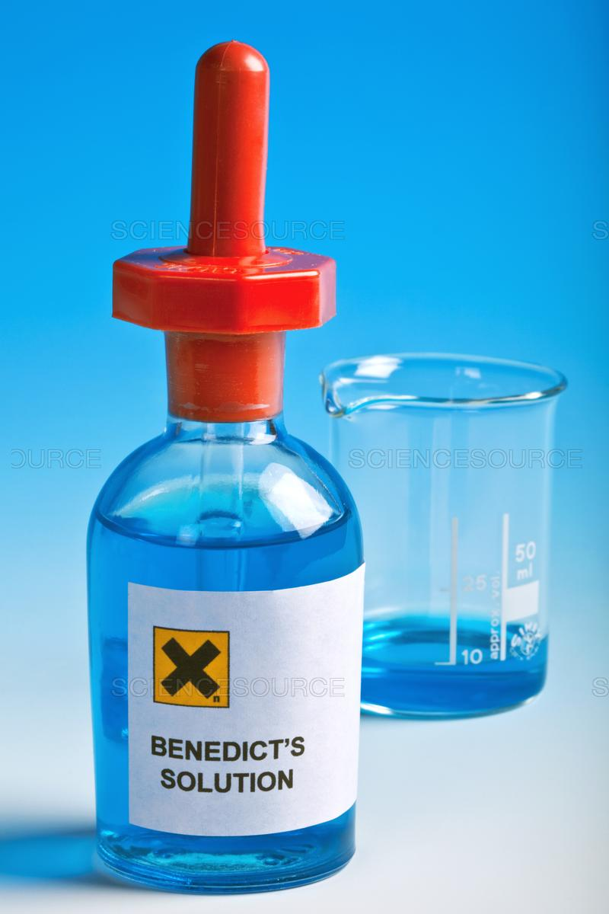
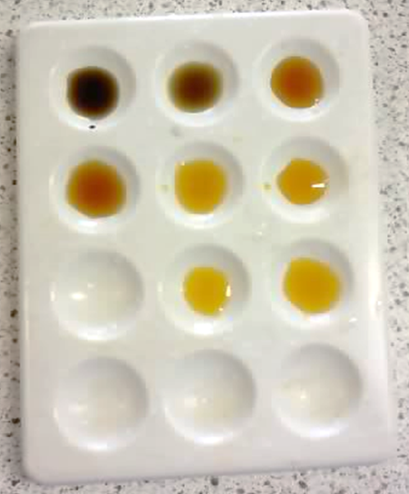
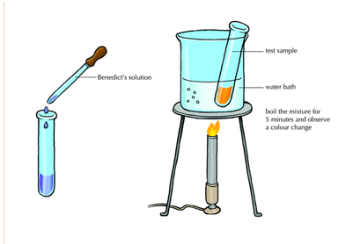
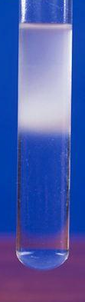
8 Practicals. A quick Recap.
3. Testing foods (Separate Science)
Benedicts test for sugars
Iodine for starch
Ethanol makes the fat precipitate
Emulsion test for lipids (or fats)
Biurette test for proteins

Slide 6
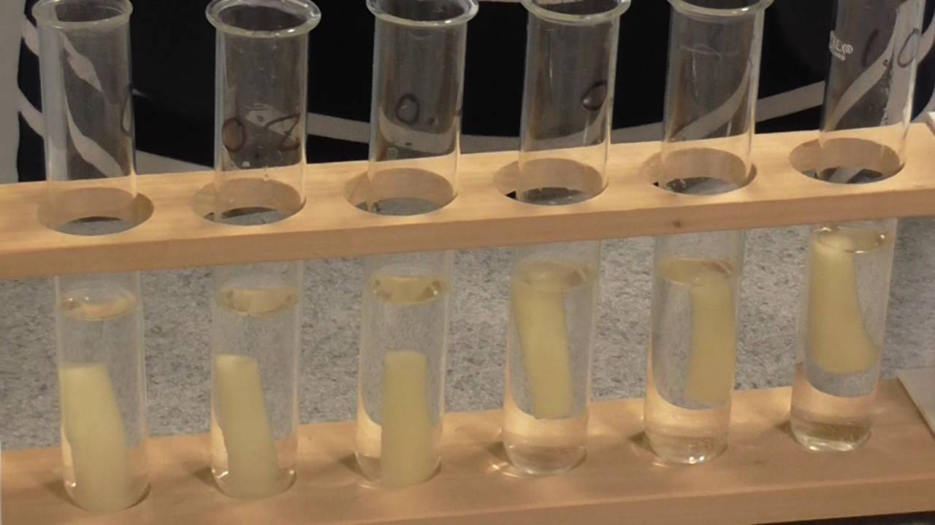
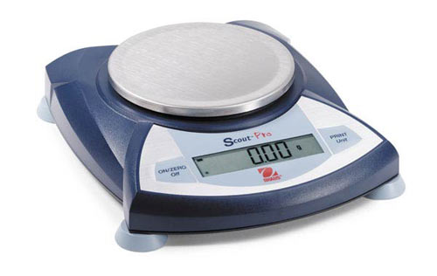
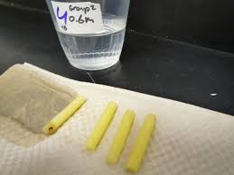
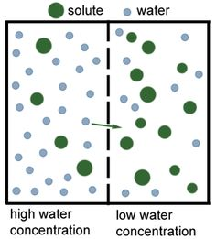
8 Practicals. A quick Recap.
Calculate percentage change in mass
4. Osmosis in potato strips
(start mass – final mass )
X 100
Start mass
Mass balance
Water diffuses from a high to a low concentration gradient through a semi-permeable membrane

Slide 7
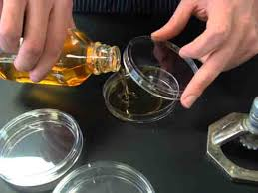
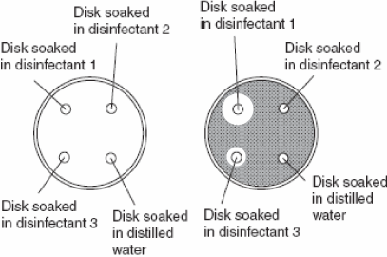
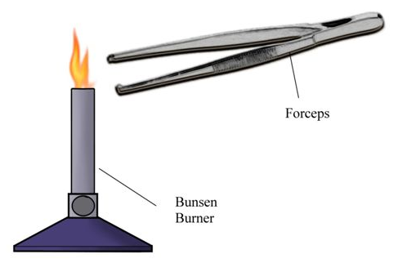
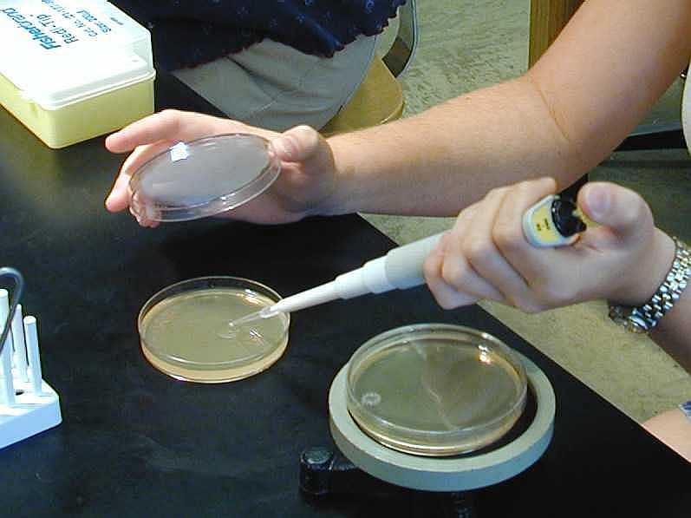
FLAME the neck of the AGAR bottle
4. Effect of disinfectants on
microbes. (Separate science)
Flame forceps before touching paper discs
Pour the agar on to a sterile plate
When the agar jelly set we added bacterial culture

Slide 8
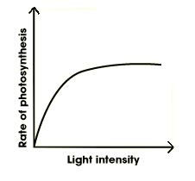
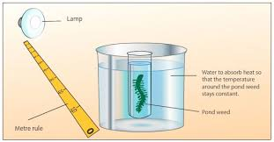
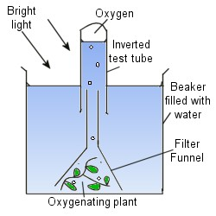
Factors limiting photosynthesis. Three factors can limit the speed of photosynthesis: light intensity, carbon dioxide concentration and temperature. Without enough light, a plant cannot photosynthesise very quickly, even if there is plenty of water and carbon dioxide
CONTROL
VARIABLES
Same:
Mass of pondweed,
Volume of water,
Temp of water.
Type of lamp/bub.
5. How Light Intensity Affects Photosynthesis.
Or trap bubbles of oxygen from pondweed.
Use a measuring cylinder instead to measure the oxygen bubbles produced.
You can use bottles of algae which photosynthesise underwater.
They produce CO2 which is acidic and changes the colour of water if we put indicator in it.

Slide 9
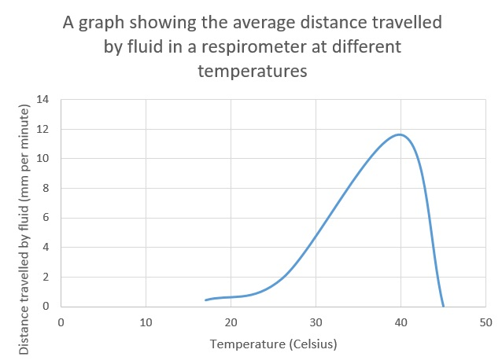
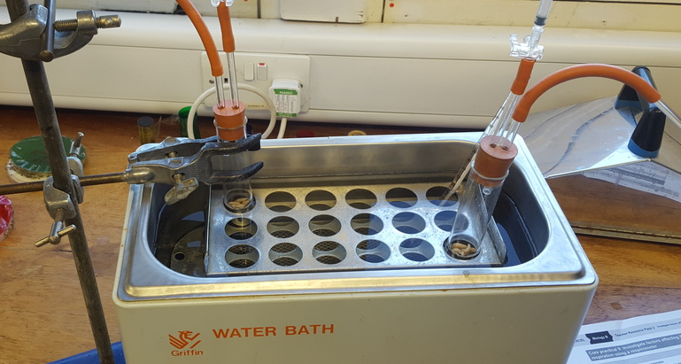
6. Investigating Respiration at different temperatures
(glucose + oxygen -> carbon dioxide + water)
WHY?
WHY?
WHY?

Slide 10
7. Fieldwork
Distance along transect (m) | Soil pH | Light intensity (lux) | Number of plants
1
5
10
15
Suggest a reason why a change in light intensity will change the number of plants living on that patch of ground.
BELT TRANSECT

Slide 11
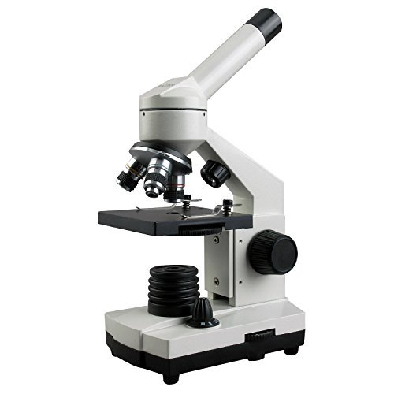
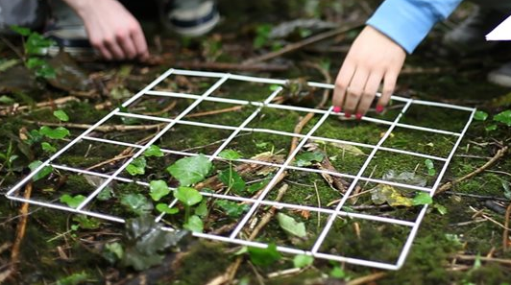
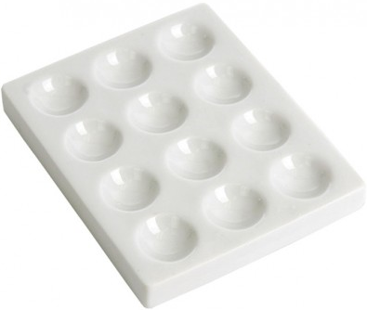
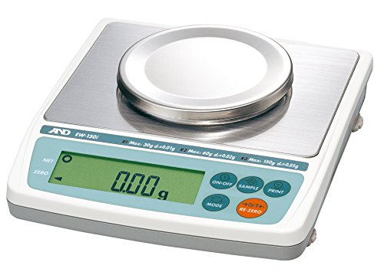

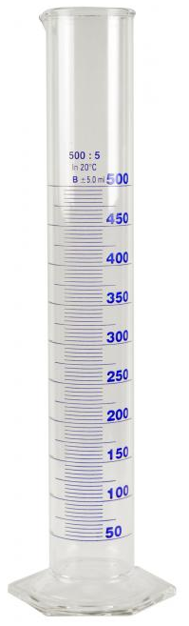
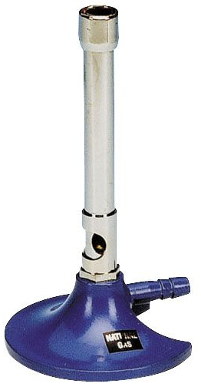
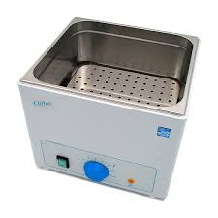
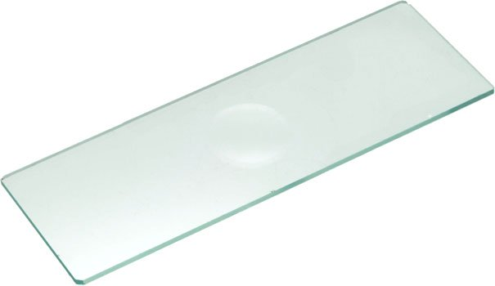
Equipment challenge. Which practical are these pieces of apparatus from? What are they called and what do they do? Some are used in more than one practical.

